Slide 1

Literature Review
Auto-Tables: Synthesizing Multi-Step Transformations to Relationalize Tables without Using Examples.
As presented by Peng Li, Yeye He, Cong Yan, Yue Wang, Surajit Chaudhuri
Presented by
Satya Nandikeswara rao Chinta, A20516065
Bavith Kumar Reddy Komtireddy, A20518408
Ahaan Kareem, A20513492

Slide 2
Agenda
1) Introduction
2) Challenges
3) Related Work
4) Preliminaries
5) Problem
6) Learning to Synthesize
7) Experiments
8) Conclusions

Slide 3

Abstract
In traditional databases, tables are structured in a specific way: each row represents an entity (like a person or an item), and each column provides information about that entity (such as age or price). However, not all tables conform to this standard format, particularly those encountered in real world situations like spreadsheets or on the web.
The paper explores the structure of tables in traditional databases, where each row corresponds to a unique entity, and each column represents a specific attribute associated with that entity, like age or price. However, real-world tables, as encountered in spreadsheets and on the web, often deviate from this standard format.
30% of these unconventional tables do not adhere to standard relational rules. This non-conformity poses challenges for widely used database tools like SQL, requiring users to manually implement intricate transformations to make these tables compatible.
To address these challenges, Auto-Tables is a system designed to automatically generate pipelines with multi-step transformations in programming languages like Python. These transformations convert non-standard tables into the standard relational format, eliminating the need for users to manually program these intricate changes.

Slide 4
Introduction
Modern data analytics tools, such as SQL and BI, rely on a standard format of relational tables.
In a random sampling of user spreadsheets (in Excel) and web tables (from Wikipedia), approximately 30-50% of tables exhibit such issues.

Slide 5
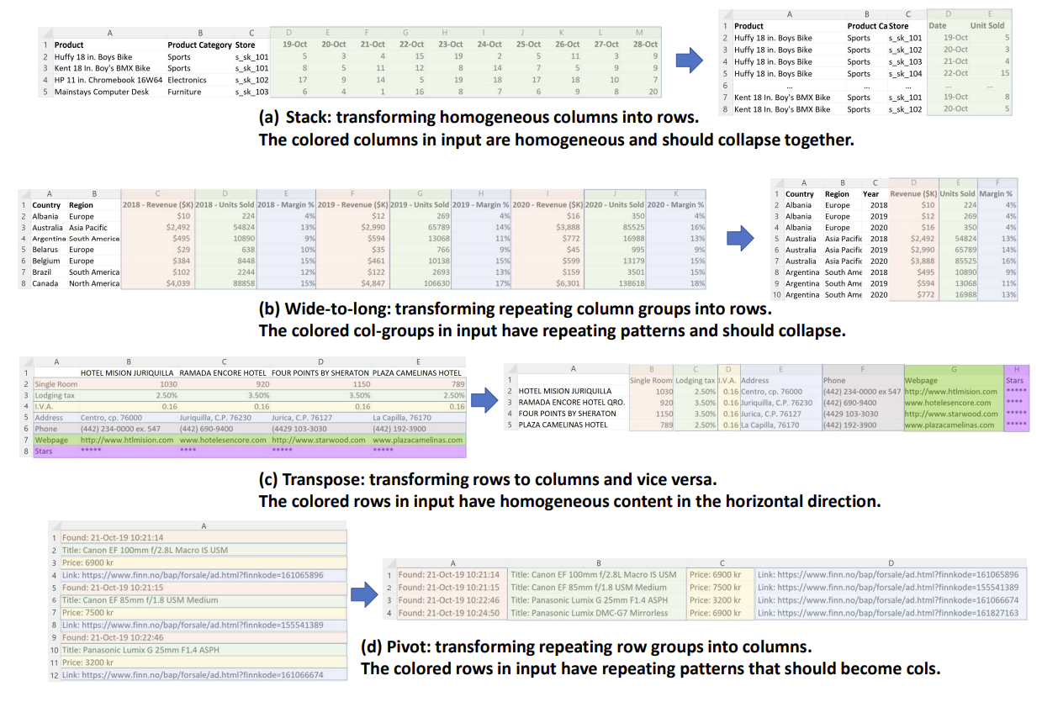

Slide 6
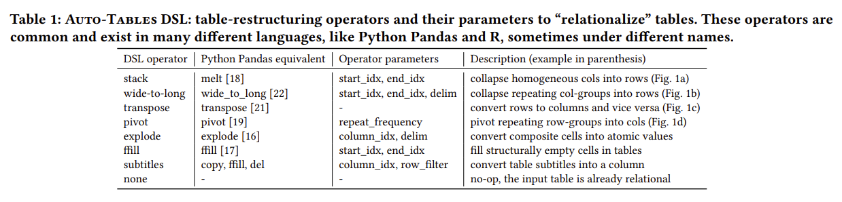
The Table outlines eight common transformation operators needed to make non-relational tables compatible with SQL-based analysis. These operators include "stack," "wide-to-long," "transpose," and "pivot," among others. Understanding and applying these operators are crucial for making diverse tables amenable to relational analysis.

Slide 7
Even though functionalities similar to those in Table exist in languages like R and Python, using them correctly is not easy for users.
Users must visually spot structural issues in a table that make querying difficult, which isn't obvious to non-experts.
Users need to connect the identified pattern to the right operator in Table 1, a challenge since they may not be familiar with specific terms (like pivot or stack).
Users must set up the chosen operator correctly, using parameters tailored to the input table, like deciding which columns to collapse into rows. This is tough, even for developers who often need to consult complex API documentation.
Some tables require more than one transformation step, meaning users must repeat steps (1)-(3) multiple times.

Slide 8

Auto-Tables: Transforming Tables Without Examples
a new approach to automatically transform tables into a standard format using a set of operations listed in Table 1. Importantly, the approach doesn't require users to provide specific examples of what they want. The idea is that, given a table, the necessary steps to make it fit the standard format are usually unique and clear. This is because our transformations only "restructure" tables without changing the content, unlike other methods that alter the table content and require examples to show the desired outcome.
As humans, we can visually recognize patterns in rows and columns (like color-coded groups in Figure 1) to predict which operation to use. The question explored in this paper is whether an algorithm can "learn" to recognize these patterns by just looking at the input tables, similar to how computer-vision algorithms identify more complex objects in pictures.

Slide 9

Related Work
The use of examples in program synthesis has been widely studied, focusing on input/output transformations. One set of methods concentrates on "row-to-row" transformations, where each input row corresponds to a single output row.
In the realm of computer vision, notable progress has been made in object detection using CNN architectures to extract vital visual features from images.
Various techniques have been proposed to represent tables using deep models, such as TaBERT, Tapas, and Turl. However, most of these concentrate on the natural-language aspects of tables, tailored to NL-related tasks like NL-to-SQL and entity-linking.
In classical database research, schema design often involves normalizing or decomposing large tables into smaller ones to satisfy relational "normal forms" (3NF, BCNF, etc.), improving storage efficiency and preventing update anomalies. In contrast,the work centers on restructuring an input table to enhance query ease, focusing on single-table-to-single-table transformations. Consequently, our approach is both independent of and complementary to schema design.

Slide 10
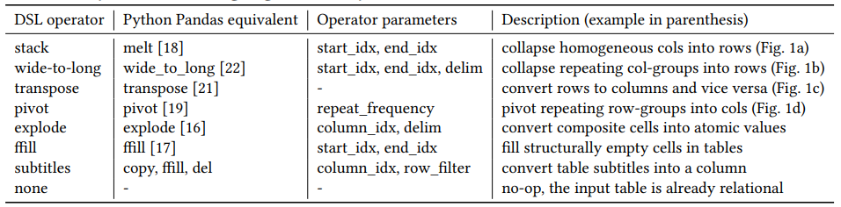
Preliminaries - Understanding Non-Relational Tables
Non-relational tables, characterized by their irregular formats, are common in various data sources, including web and spreadsheet data.
The challenges with non-relational tables lie in their incompatibility with SQL querying, which relies on a structured, relational format.
These operators cover most scenarios required to make tables suitable for relational analysis.
It's important to note that the synthesis framework, utilizing self-supervision for training, isn't bound to specific operator choices. This flexibility enables us to easily incorporate additional operators for new functionalities.

Slide 11
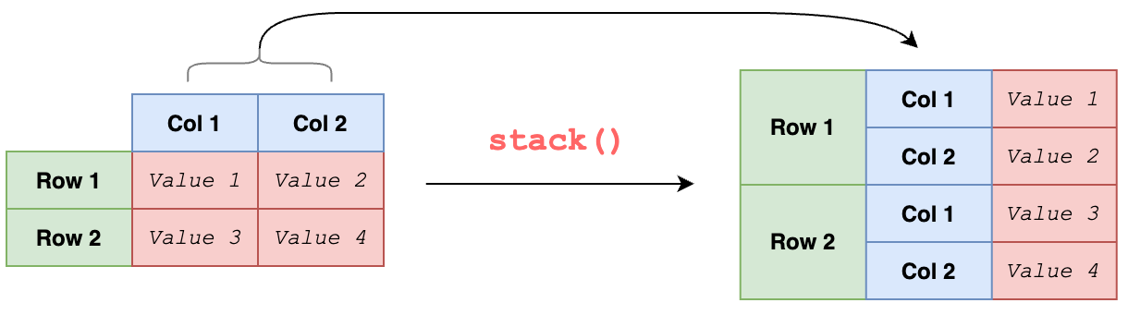
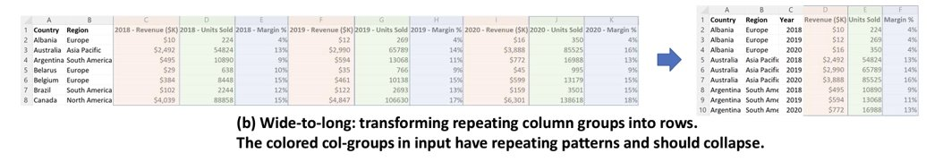
Stack
Operator: Pandas Stack (also known as melt and unpivot in other contexts)
• Function: Collapses contiguous blocks of homogeneous columns into two new columns.
• Parameters: Requires start_idx and end_idx, specifying the starting and ending column index of the homogeneous column group to be collapsed.
2. Wide-to-long
Operator: Pandas Wide-to-Long (similar functionality in R)
Function: Collapses repeating column groups into rows.
Parameters: Requires start_idx, end_idx, and "delim" (delimiter used to split original column headers).

Slide 12
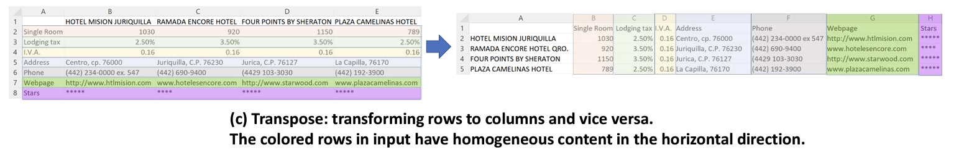
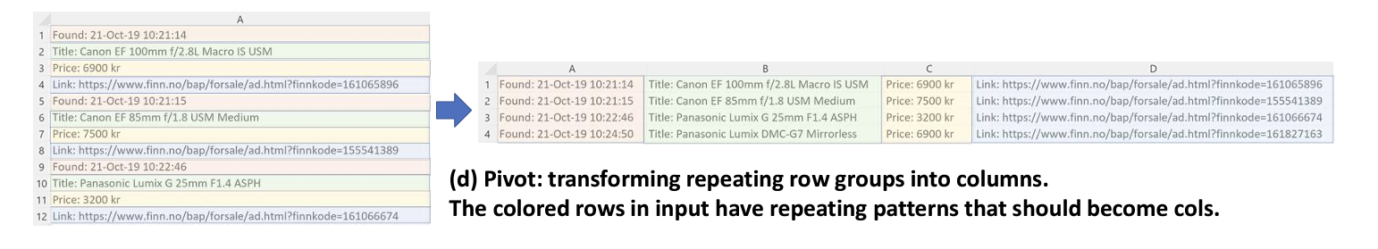
3. Transpose
Transposes rows to columns and columns to rows.
Parameters: No parameters are needed, as all rows and columns will be transposed.
4. Pivot
Converts rows to columns (with repeating groups).
Parameters: Requires "repeat_frequency" to specify the frequency at which rows repeat in the input table.

Slide 13
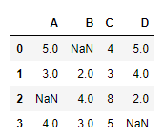
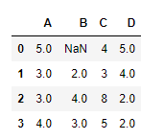
5. Explode
Converts columns with composite values into atomic values.
6. Ffill
fills values in structurally empty cells so that the table can be queried
Before Ffill
After Ffill
7. Subtitle
Converts rows representing table subtitles into separate columns.
8. None
For input tables already relational, no transformation is needed.

Slide 14
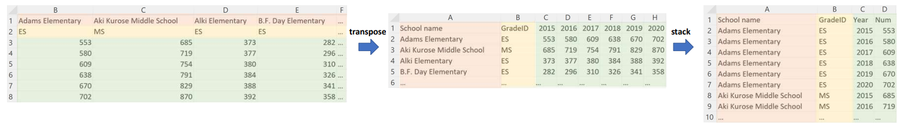
Problem Statement
We've got a table, and our goal is to modify it using specific operations like "stack," "transpose," and "pivot." These operations have precise methods of altering the table, and our objective is to determine the correct sequence of these operations, along with their specific settings, to create a more organized and user-friendly table.

Slide 15
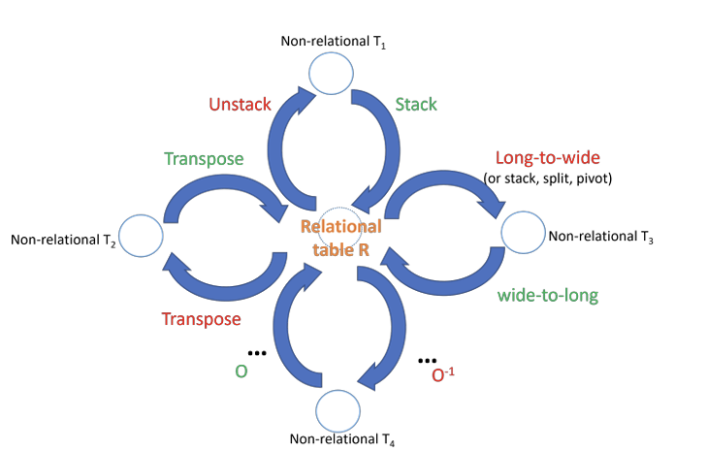
Auto-Tables
Auto-Tables is an innovative solution that uses machine learning to automate the restructuring of non-relational tables.
It stands out by requiring minimal user input and leveraging advanced algorithms for data transformation.
This system is designed to make non-relational data easily accessible and usable for SQL-based analytics tools.
This slide serves as an introduction to the fundamental concept and functionality of Auto-Tables.

Slide 16
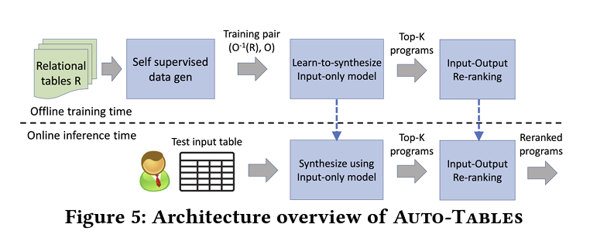
Problem
Auto-Tables addresses the specific issue of transforming non-relational tables into a standardized relational format.
The core challenge is the diverse nature of non-relational data, which doesn't fit neatly into the rigid structure of relational databases.
The solution needs to be automated, efficient, and capable of handling various data inconsistencies.
This slide defines the scope and scale of the problem that Auto-Tables aims to solve.

Slide 17
Learning to Synthesize
This system employs table embedding layers, which are integral to processing and interpreting complex table data.
Dimension reduction and feature extraction are key processes in refining the data for optimal performance within the model.
The architecture is designed to facilitate systematic, step-by-step transformation of non-relational tables.

Slide 18
Auto-Tables utilize a unique training approach, employing inverse operators to generate a wide variety of training data.
The iterative prediction method plays a pivotal role in systematically transforming tables.
This self-supervised learning approach is a cornerstone of Auto-Tables' effectiveness and efficiency in handling diverse data formats.
Auto-Tables is distinguished by its ability to process data transformations without the need for user-generated examples.
It boasts rapid processing capabilities, enabling quick turnaround times for data restructuring.
The system's adaptability to various table formats and structures is a key feature, making it versatile in different data environments.

Slide 19
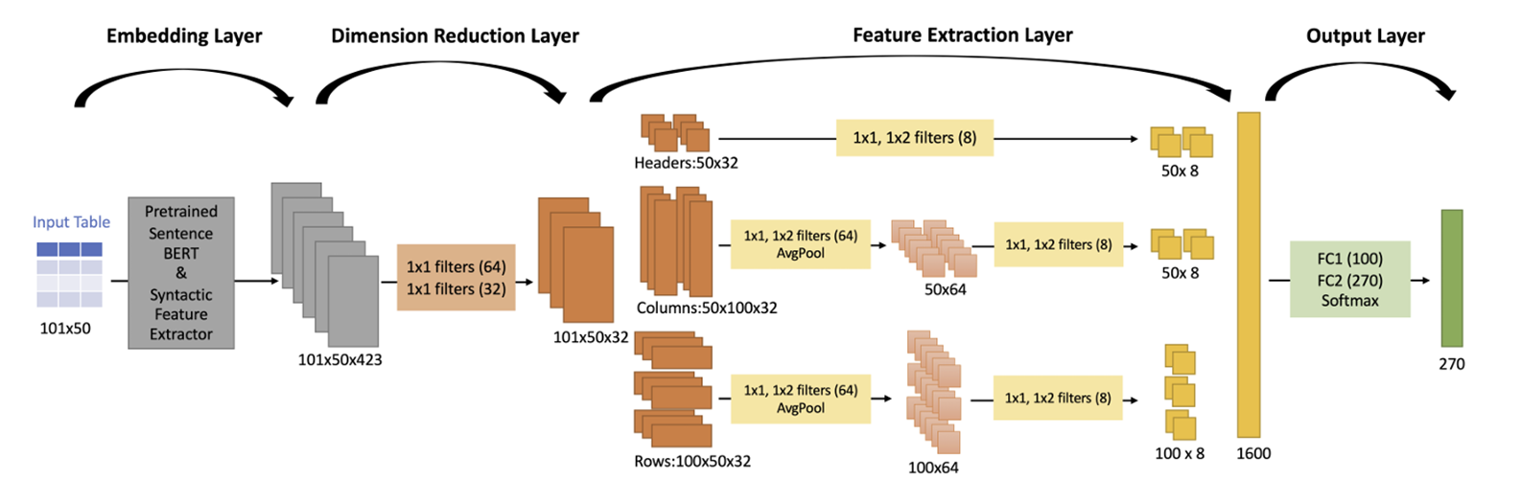
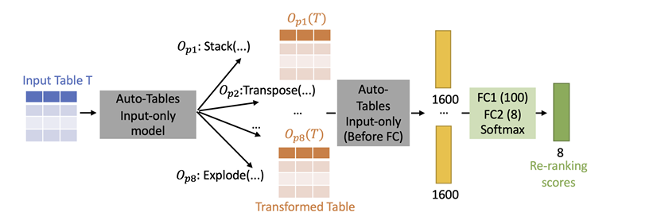
Input-only synthesis: model architecture
Input/output re-ranking: model architecture

Slide 20
Experiments
The success rate and efficiency of Auto-Tables are emphasized, showcasing its effectiveness in real-world scenarios.
The comparative analysis provides a clear picture of where Auto-Tables stands in relation to existing data transformation tools.
A deep dive into the efficiency and latency aspects of Auto-Tables reveals its quick data processing capabilities.
The system's speed and responsiveness are compared with other methods, highlighting its superiority in practical applications.

Slide 21
Ablation studies provide insights into how various components and settings influence the performance of Auto-Tables.
These studies are crucial for understanding the system's robustness and identifying areas for further optimization.
The results of these studies offer a comprehensive view of the system's functionality under different configurations.

Slide 22
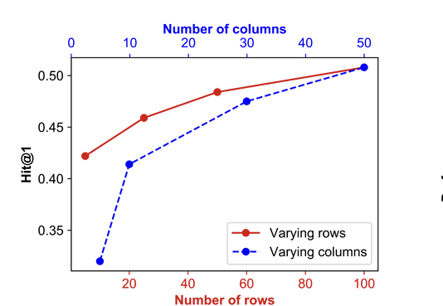
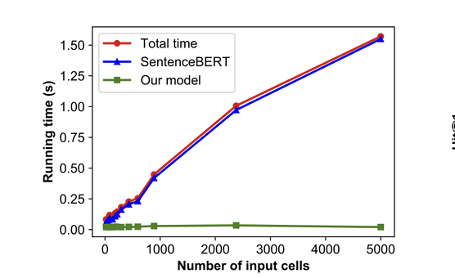
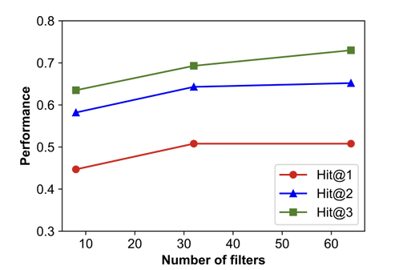
Auto-Tables latency analysis
Vary input size
Vary number of filters

Slide 23
Conclusion and Future Directions
Summarizing the key points of Auto-Tables, the paper emphasizes its impact and value in the realm of data management.
Potential future enhancements and research directions are discussed, highlighting the ongoing development of Auto-Tables.
The broader implications of Auto-Tables for data analysis and management are considered, reflecting on its influence in the field.

Slide 24
Critique
The "Auto-Tables" technology represents a significant step forward in the world of table transformation, showcasing the potential of algorithms that can teach themselves. While the paper has strengths in its innovative approach and thorough experiments, addressing certain areas for improvement will enhance its overall contribution and provide a more solid understanding of what "Auto-Tables" can offer and where it might fall short.
Evaluation Metrics: The paper primarily uses Hit@k metrics to evaluate transformation quality. Incorporating additional metrics that consider precision, recall, or specific use-case scenarios would offer a more nuanced evaluation.
User-Friendliness and Practicality: The paper emphasizes the user-friendliness of AutoTables, but it could benefit from a discussion on potential challenges or limitations faced by users in real-world scenarios. Understanding the practical implications and potential user difficulties would add depth to the analysis.
Broader Implications: The discussion on future work could benefit from a broader exploration of how Auto-Tables might impact the fields of data science, automation, and human-computer interaction. Identifying challenges or ethical considerations would contribute to a more comprehensive research agenda moving forward.

